Slide 1
The Role of Journalism in Scientific Research
Kristen Hwang
Faculty Adviser: Nicole Cassis

Slide 2
Outline
Scientific communication challenges and solutions
What is science journalism?
Benefits and tradeoffs of science journalism
Communication Model & How to tell a story
Work at ASU
Recommendations for researchers

Slide 3

Challenges and Solutions
Knowledge gap between researchers and average Americans
  Average reading level: 7th grade (HHS)
  Less than 50% of Americans know what scientists and engineers do (NSF)
Bridge the gap
Source: Wikimedia Commons

Slide 4
What is science journalism?

Slide 5
Journalism is not:
Journalism is:
Tabloids
Movies
Advertising
Blogs
Paparazzi
TMZ, MTV, Tonight Show
An effort to support a particular side of an issue or an effort to convince the public to support a particular side of an issue
An effort to find the facts and tell the truth
A means of engaging and informing the public about current events
A means of creating discussion about current events
Newspapers, news radio, television news, accompanying news websites

Slide 6
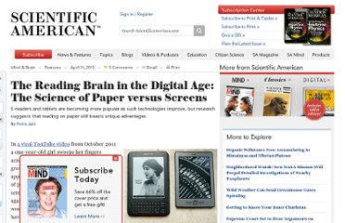
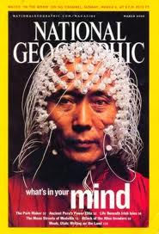
Science Journalism
A means of bridging the gap between scientists/engineers and the general public
  Distilling complicated information into its most basic form
  Storytelling
  Graphics
Source: Wikimedia Commons

Slide 7
Benefits and Tradeoffs
Benefits
Tradeoffs
People know what you’re researching and what you’ve discovered
People are informed
People are inspired
You get the chance to tell people why your work is important
You don’t get to read the story before it’s published
You have to trust the journalist
There is a fine line between what is accurate and what is important

Slide 8
Communication Model
Religious beliefs
Other entertainment
options
Trust
Jargon
Politics
Knowledge gap
Message
Sender
(scientist)
Journalist
Receiver
(reader)
Feedback

Slide 9
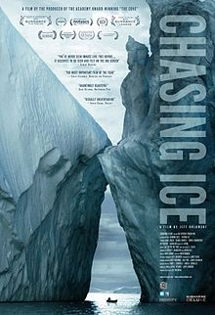
Storytelling basics
Find a story
Get all the facts
Attach the story to a character
Focus on the WHY (why is this important to people, why should they care)
Play to readers’ emotions
Hit the readers with facts
Ending
Source: Wikimedia Commons

Slide 10
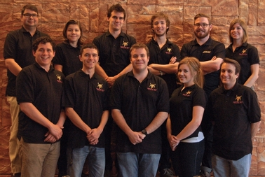
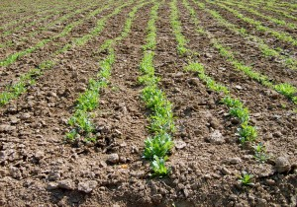
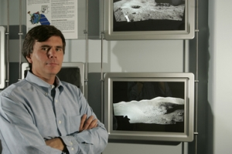
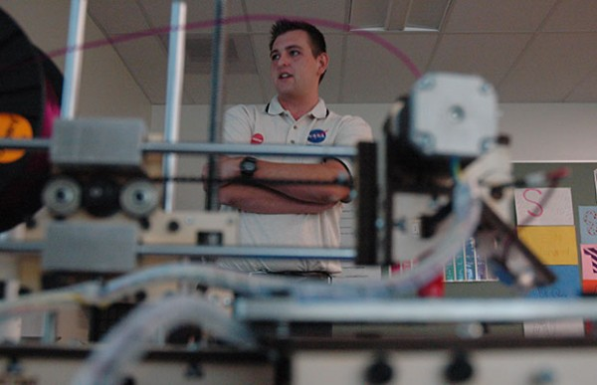
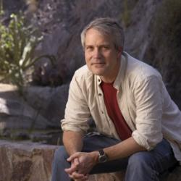
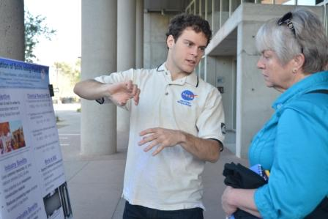
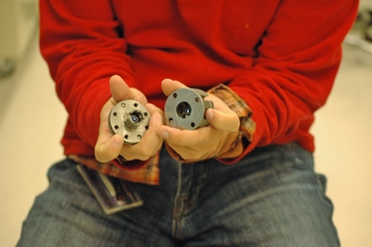
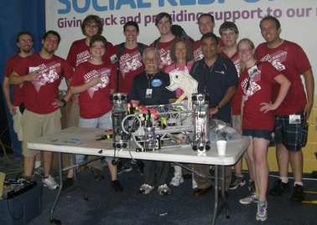
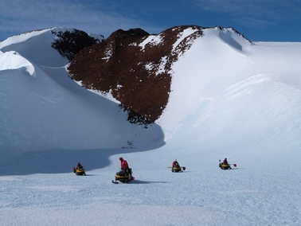

Slide 11
Recommendations for Researchers
Establish a good relationship with your PIO
  Keep them updated
  Respond to their emails
Understand that news is timely
  Embargoes
When interviewing:
  Think of analogies
  Use pictures or diagrams
  Send your paper to the reporter before the interview

Slide 12
“It doesn’t matter what we discover if we do it by ourselves. It could be the most important discovery ever to the handful of people in your field, but it doesn’t matter if you don’t tell people about it.”
-Tom Sharp
Associate Director, Arizona Space Grant Consortium

Slide 13
Thank you

